Slide 1
Soft Switching Techniques in DC-DC Converters for Battery Management Systems
ATUL TIWARI
14 July 2024

Slide 2
Abstract
DC-DC soft switching techniques reduce switching losses and stress on electronic components during transitions between the on and off states of power switches. Soft switching ensures switching occurs when either the voltage across the switch or the current through it is zero, minimizing losses. The two main types are Zero Voltage Switching (ZVS) and Zero Current Switching (ZCS).

Slide 3
Introduction
The increasing demand for efficient power management and conversion systems has driven advancements in DC-DC converter technology. This report presents a novel soft-switching bi-directional DC-DC converter design, reducing switching and conduction losses, preventing the reverse recovery phenomenon in the main diode, and minimizing EMI.

Slide 4
Zero Current Switching (ZCS): Zero Current Switching is a technique used in power electronics to reduce switching losses and stress on the components. In ZCS, the switching of the transistor occurs when the current through it is zero, effectively minimizing the current-induced switching losses and electromagnetic interference (EMI). This method is particularly beneficial in high-power applications where reducing stress on components is crucial for enhancing the overall efficiency and reliability of the system.
Zero Voltage Switching (ZVS): Zero Voltage Switching is another method to improve efficiency in power electronic circuits by reducing switching losses. In ZVS, the switching occurs when the voltage across the switching device is zero, which minimizes voltage-induced switching losses and reduces stress on the transistor. This technique is widely used in resonant and soft-switching converters, where it helps in achieving higher efficiency and prolonging the life of the components by minimizing thermal stress and EMI.

Slide 5
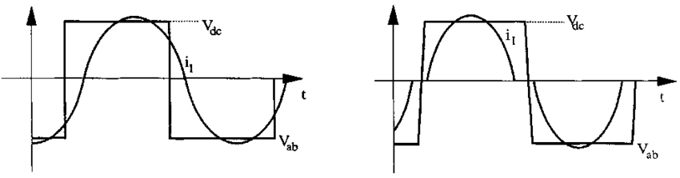
ZCS

Slide 6
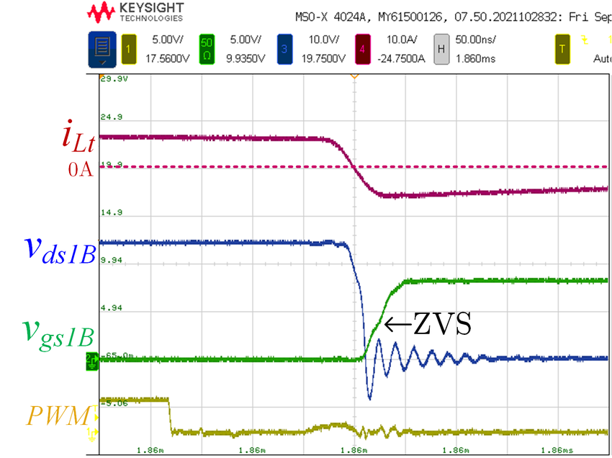
zvs

Slide 7
Buck and Boost Converter
A buck-boost converter operates by using a combination of switches, typically transistors, and energy storage elements such as inductors and capacitors to regulate the input voltage to the desired output voltage. During operation, the converter alternates between two main phases: in the first phase, the switch (transistor) is turned on, allowing current to flow through the inductor, storing energy in its magnetic field. In the second phase, the switch is turned off, causing the inductor to release its stored energy through the diode and to the output capacitor, which then supplies a steady voltage to the load. By adjusting the duty cycle of the switching signal, the converter can control the amount of energy transferred, thereby either increasing or decreasing the output voltage.
The buck-boost converter is particularly advantageous because it can seamlessly transition between buck (step-down) and boost (step-up) modes, depending on the input voltage relative to the desired output voltage. If the input voltage is lower than the required output, the converter operates in boost mode, increasing the voltage. Conversely, if the input voltage is higher than needed, it operates in buck mode, decreasing the voltage. This dual capability makes the buck-boost converter highly versatile and efficient, especially in applications with fluctuating input voltages, such as battery-powered devices and renewable energy systems.

Slide 8
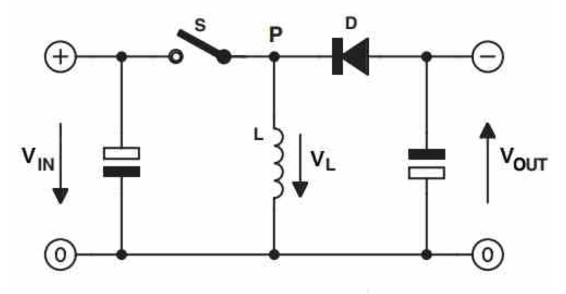

Slide 9
Components
Main Inductor (Lm)
Resonant Inductor (Lr)
Resonant Capacitors (Cr1, Cr2)
Main Switches (S1, S2)
Auxiliary Switches (Sa1, Sa2)

Slide 10
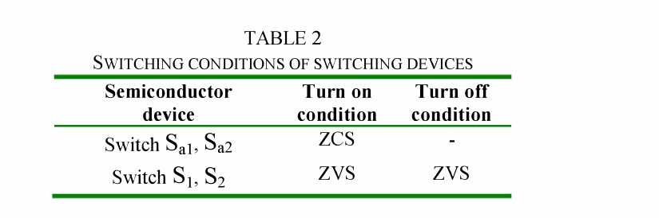

Slide 11
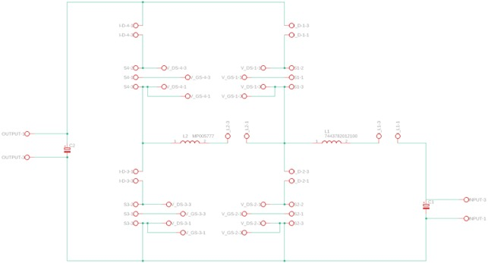
Schematic

Slide 12
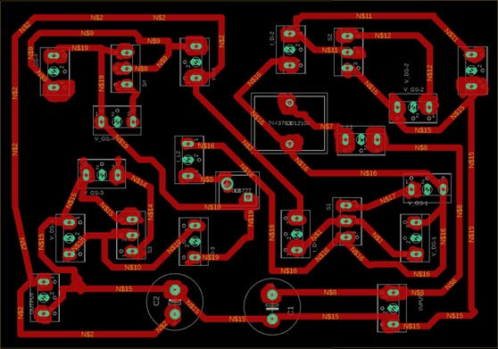
Board File

Slide 13
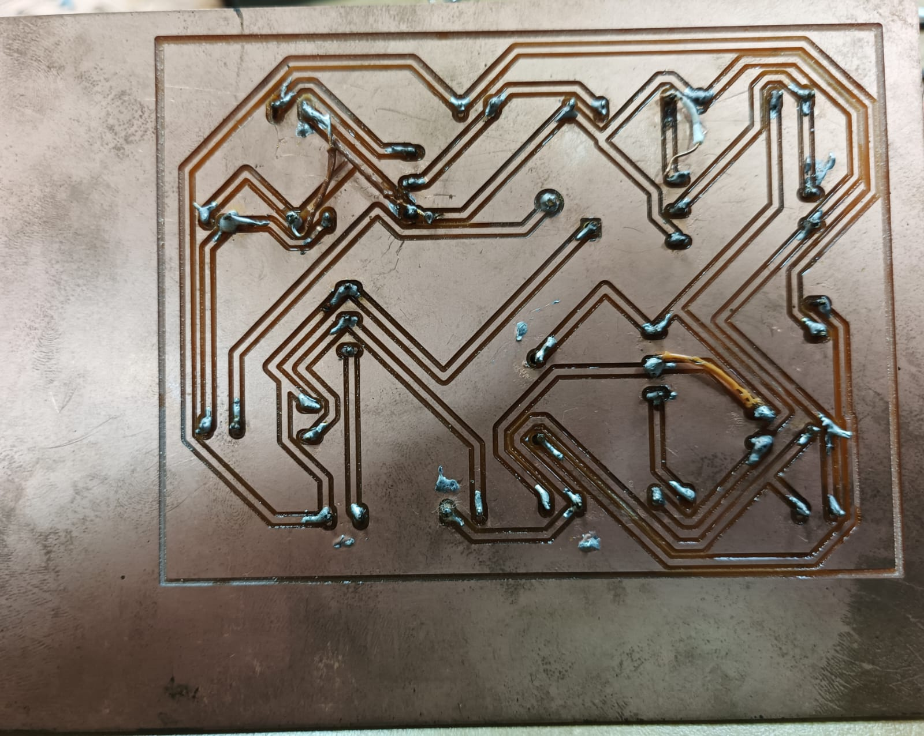
PCB (soldered)

Slide 14
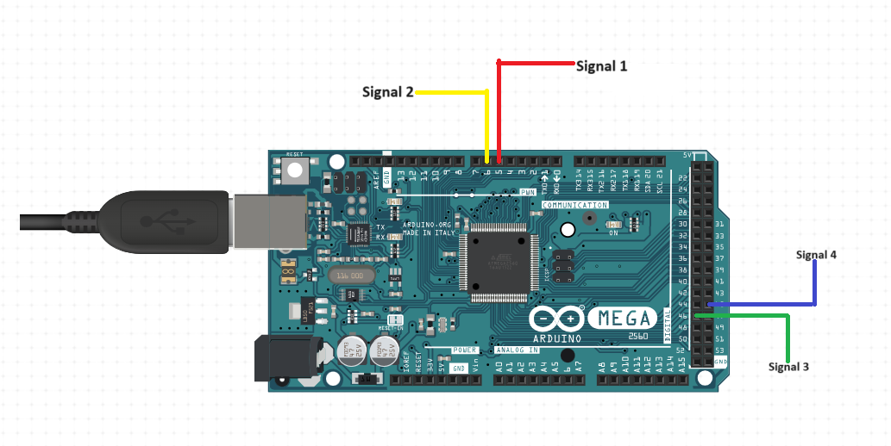
Arduino (signals)

Slide 15
code
// DUTY CYCLE
OCR3A = (int) (ICR3 * 0.46);
OCR4A = (int) (ICR4 * 0.41);
OCR5A = (int) (ICR5 * 0.50);
OCR5B = (int) (ICR5 * 0.02);
// INIT TMR AT 0x00
TCNT5=0x0;
TCNT4=0x0;
TCNT3=0x0;
sei(); //enable interrupts
TCCR3B |= 1; // Prescale=1, Enable Timer
no_op(5);
TCCR4B |= 1; // Prescale=1, Enable Timer
no_op(11);
TCCR5B |= 1; // Prescale=1, Enable Timer
}
void loop() {
digitalWrite(LED_BUILTIN, HIGH);
delayMicroseconds(5000);
digitalWrite(LED_BUILTIN, LOW);
delayMicroseconds(500);
}
void no_op(int delay)
{
for (int i=0; i<=delay; i++) asm("nop");//No Operation
}
void setup() {
pinMode(5, OUTPUT); // OC3a
pinMode(6, OUTPUT); // OC4a
pinMode(46, OUTPUT); // OC5a
pinMode(45, OUTPUT); // OC5b
pinMode(LED_BUILTIN,OUTPUT);
cli(); //disable interrupts
TCCR5B = 0x18; // 0001 1000, Disable Timer
TCCR4B = 0x18; // 0001 1000, Disable Timer
TCCR3B = 0x18; // 0001 1000, Disable Timer
TCCR5A = 0xAA; // 1010 1010
TCCR4A = 0xA2; // 1010 0010
TCCR3A = 0xA2; // 1010 0010
//TOP value
ICR5 = 160-1;
ICR4 = 160-1;
ICR3 = 160-1;

Slide 16
Gate Driver Circuit

Slide 17
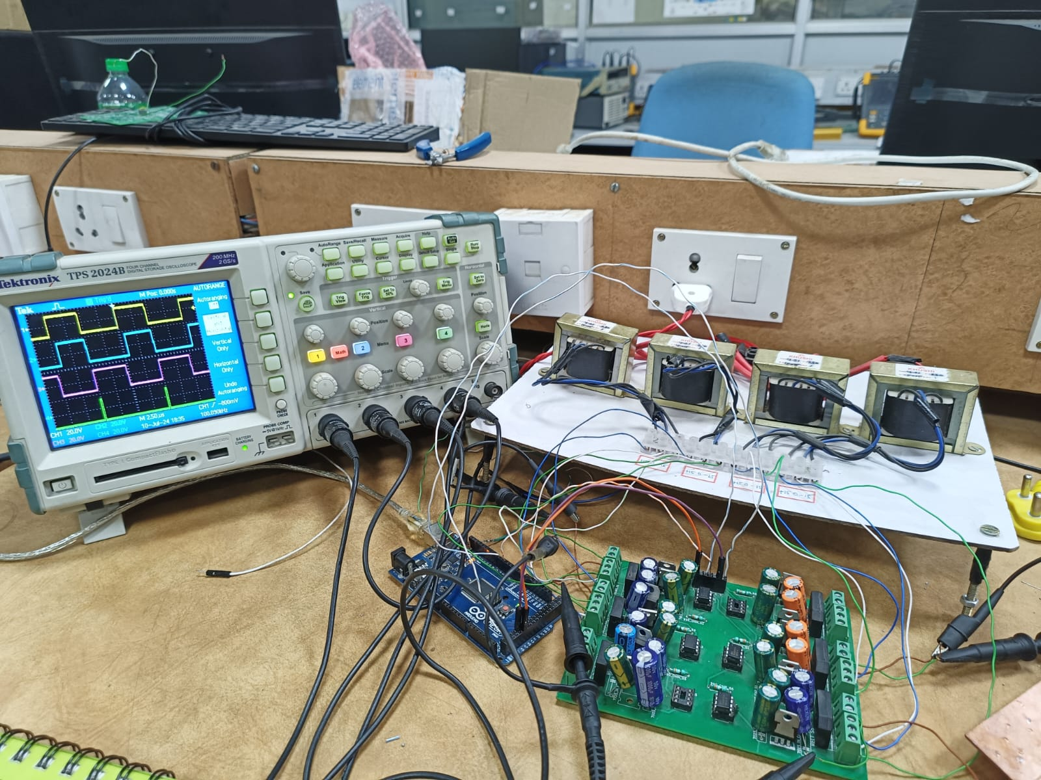
Experimental Setup

Slide 18
Simulation Results
Resonant Condition:
Resonant Inductor: Calculated value to satisfy resonance condition is 84.1 μH, but 100 μH was used.
Resonant Capacitor: Calculated value is 20.29 nF, but 3.3 nF was used.
Soft Switching Operations:
ZVS (Zero Voltage Switching) Turn-On and Turn-Off: Achieved for the main switch.
ZCS (Zero Current Switching) Turn-On: Achieved for the auxiliary switch.
Current and Voltage Waveforms:
Waveforms for both boost mode and buck mode operations indicate successful ZVS and ZCS operations.
Main Inductor Current (ILmI_{Lm}ILm​):
Peak: 6.47 A
Minimum: 3.53 A
Resonant Inductor Current (ILrI_{Lr}ILr​):
Peak: 8.411 A

Slide 19
5. Resonant Peak Voltage (Vcr−peakV_{cr-peak}Vcr−peak​):
VoV_{o}Vo​: 400 V
6. Timing and Control:
Delay logic is essential for the system to ensure proper timing between the main and auxiliary switches.
Control block uses a sawtooth waveform for designing fixed switch-on time, and a PI controller for voltage regulation.
These numerical results validate the improved efficiency and reduced switching losses of the proposed bidirectional DC-DC converter with ZVT switching, as compared to conventional designs.

